Slide 1
DATA STRUCTURES (CS3401)
Dr. Somaraju Suvvari,
Asst. Prof, Dept. of CSE, NIT Patna.
somaraju@nitp.ac.in;
soma2402@gmail.com;

Slide 2
The Course
DATA STRUCTURES

Slide 3
TREES
&
GRAPHS

Slide 4
UNIT V: Trees & Graphs
Binary tree, Binary search tree, Threaded binary tree, AVL Tree, B Tree, Tries, Heaps, Hash tables.
Graph and its implementation, Graph traversals: Breadth First Search, Depth First Search, Union-find data structure and applications, Spanning Tree – Prim’s algorithm and Kruskal’s algorithm, Shortest path- Dijkstra's algorithm and Bellman Ford algorithm., Topological sorting for Directed Acyclic Graph.

Slide 5
Trees
One way to define tree is recursively. “Tree is a non-linear data structure and it is a collection of nodes. The collection may be empty ; otherwise, a tree consists of a distinguished node called root, r, and zero or more non empty (sub) trees T₁, T₂, ….T_{k}, each of whose roots are connected by a directed edge from r”.
In tree data structure, every individual element is called as Node.
Node in a tree data structure stores the actual data and a link to next element in hierarchical structure.

Slide 6
Trees Terminology
Root
Edge
Parent
Child
Siblings
Leaf
Internal Nodes
Degree
Level
Height
Depth
Path
Sub-Tree
In-degree
Out-degree
Root
Top most node in the tree.
If Root is NULL means that tree is empty.
Tree contains only one Root node.
Root node is the top most node in the tree. If Root is NULL means that tree is empty.
TOP
T
A
Edge
The connecting link between any two nodes in a tree is called as EDGE.
In a tree with 'N' number of nodes there will be a maximum of 'N-1' number of edges.
Edge
T₁
B
F
T₂
T₃
T₄
T₅
T₇
T₈
C
D
E
G
I
T₆
T₉
H
J
BOTTOM
There are totally 10 nodes (in general n nodes), 9 edges (in general n-1 edges).
T₁ and T₂ are sub-trees of Root node T, and T₃, T₄, T₅ are the subtrees of T₁, ……

Slide 7
Tree - Terminology
Root
Edge
Parent
Child
Siblings
Leaf
Internal Nodes
Degree
Level
Height
Depth
Path
Sub-Tree
In-degree
Out-degree
A
B
C
Parent
The node which is a predecessor of any node is called as PARENT NODE.
The node which has child / children
The node which has a branch from it to any other node is called a parent node.
The root node does not have any parent.
D
E
F
G
H
I
J
K
The parent nodes here are: A, B, C, E, G

Slide 8
Tree - Terminology
Root
Edge
Parent
Child
Siblings
Leaf
Internal Nodes
Degree
Level
Height
Depth
Path
Sub-Tree
In-degree
Out-degree
Child
The node which has a link from its parent node is called as child node
The node which is descendant of any node is called as CHILD Node
Parent node can have any number of child nodes.
All the nodes except root are child nodes.
A
B and C are child nodes of A
B
C
G and H are the child nodes of C
D, E, F are child nodes of B
D
E
F
G
H
I and J are the child nodes of E
I
J
K
K is a child node of G

Slide 9
Tree - Terminology
Root
Edge
Parent
Child
Siblings
Leaf
Internal Nodes
Degree
Level
Height
Depth
Path
Sub-Tree
In-degree
Out-degree
Siblings
The nodes which belong to same Parent are called as SIBLINGS.
In simple words, the nodes with the same parent are called Sibling nodes.
A
B
C
B and C are siblings
D, E and F are siblings.
D
E
F
G
H
G and H are siblings.
I and J are Siblings
K
I
J

Slide 10
Tree - Terminology
Root
Edge
Parent
Child
Siblings
Leaf
Internal Nodes
Degree
Level
Height
Depth
Path
Sub-Tree
In-degree
Out-degree
A
Leaf
The node which does not have a child is called as LEAF Node.
In simple words, a leaf is a node with no child.
B
C
D
E
F
G
H
I
J
K
F, I, J, K and H are Leaf Nodes.
A
Internal Node
The node which has at least one child is called as INTERNAL Nodes.
In simple words, an internal node is a node with at least one child.
B
C
D
E
F
G
H
I
J
K
A, B, C, E and G are the Internal Nodes

Slide 11
Tree - Terminology
Root
Edge
Parent
Child
Siblings
Leaf
Internal Nodes
Degree
Level
Height
Depth
Path
Sub-Tree
In-degree
Out-degree
A
Degree of tree is 3
Degree
The Degree of a node is the total number of children it has.
The highest degree of a node among all the nodes in a tree is called as 'Degree of Tree'
Degree of A is 2
Degree B is 3
Degree C is 2
Degree of E is 2
Degree of G is 1
Degree of D, F, H and K is 1
B
C
D
E
F
G
H
I
J
K
Level
The root node is said to be at Level 0 and the children of root node are at Level 1 and the children of the nodes which are at Level 1 will be at Level 2 and so on...
A
Level 0
B
C
Level 1
D
E
F
G
H
Level 2
I
J
K
Level 3

Slide 12
Root
Edge
Parent
Child
Siblings
Leaf
Internal Nodes
Degree
Level
Height
Depth
Path
Sub-Tree
In-degree
Out-degree
Tree - Terminology
3
Height of tree :3
Height
The total number of edges from leaf node to a particular node in the longest path is called as HEIGHT of that node.
Height of the root node is said to be height of the tree.
height of all leaf nodes is '0'.
A
2
2
B
C
0
1
0
1
0
D
E
F
G
H
0
I
J
0
K
0
A
Depth of A is 0
Depth
The total number of edges from root node to a particular node is called as DEPTH of that node
The total number of edges from root node to a leaf node in the longest path is said to be Depth of the tree.
Depth of root node is 0.
Depth (B)=1
Depth of C is 1
B
C
Depth (D) = 2
D
E
F
G
H
I
J
K
Depth(K) = 3

Slide 13
Tree - Terminology
Root
Edge
Parent
Child
Siblings
Leaf
Internal Nodes
Degree
Level
Height
Depth
Path
Sub-Tree
Indegree
Outdegree
Path between A and J is A-B-E-J and path length is 4.
Path
Sequence of nodes and edges from one node to another node is called as path.
Number of nodes in a path is the Path Length.
A
B
C
D
E
F
G
H
Sub-tree
A
J
B
C
Sub-tree
Sub-Tree
Each child from a node forms a sub-tree recursively.
Every child node will form a sub-tree on its parent node..
D
E
F
G
H
I
J
K
Sub-tree
Sub-tree

Slide 14
Tree - Terminology
Root
Edge
Parent
Child
Siblings
Leaf
Internal Nodes
Degree
Level
Height
Depth
Path
Sub-Tree
In-degree
Out-degree
In-degree-
It is the number of edges arriving at a node.
The root node is the only node that has an in-degree equal to zero.
Out-degree
Similarly, out-degree of a node is the number of edges leaving that node.
Usually, leaf nodes out-degree is zero.
In-degree(A)=0,
Out-degree of (A) is 2.
A
B
C
D
E
F
G
H
I
J
K
In-degree(B)=1, Out-degree of (B) is 3.

Slide 15
Representation of Trees
One way to represent tree is using the List representation.
The root node comes first followed by the sub tress…….
The List representation for the tree shown here:
(A (B (D, E(I), F), C(G, H)) )
Node data | Child-1 Link | Child-2 Link | …… | …….. | ……… | ………. | …….. | ……… | Child-n Link
A
A
B
C
C
D
E
F
G
H
G
H
J
B
D
E
F
The dis advantage of this approach is that it requires too many pointers
I

Slide 16
Binary Tree
Any tree can be called as Binary Tree if every node in the tree has either zero or one or two children only (A Tree where no node has more than two children).
A
B
C
D
E
G
H
J
Binary Tree

Slide 17
Types of Binary Trees
Strict Binary tree – It is a binary tree where each node has exactly two children or no children.
Full Binary Tree - It is a binary tree where each non leaf node has exactly two children and all the leaf nodes are at the same level.
A
B
C
G
H
Strict Binary Tree
A
B
C
D
E
G
H
Full Binary Tree

Slide 18
Types of Binary Trees
Complete Binary tree – In a complete binary tree, all the levels of a tree are filled entirely except the last level. In the last level, nodes might or might not be filled fully and also all the nodes should be filled from the left.
A
B
C
D
E
G
Complete Binary Tree

Slide 19
Properties of Binary Trees
In a binary tree
At level l maximum 2^{l} nodes.
The number of nodes in a full binary tree of height h is 2^{h+1} – 1, since there are h levels and at each level i there are exactly 2^{i} nodes, so 2⁰ + 2¹ + 2² + … +2^{h} = 2^{h+1} – 1.
The number of nodes in a complete binary tree is in between 2^{h} (minimum) and 2^{h+1} - 1 (maximum).
The number of leaf nodes in a full binary tree is 2^{h}.
A
B
C
D
E
G
H

Slide 20
Representation of Binary Trees
Binary trees can be represented using two ways
We can store binary trees in arrays, and specially if the tree is a complete binary tree. In this method, if a node has an index i, its children are found at indices 2*i+1 and 2*i+2, while its parent (if any) is found at index floor((i-1)/2) (assuming the root of the tree stored in the array at an index zero).
This method wastes 2^{h+1} – n – 1 for a tree of height h with n nodes.
Consider the complete tree shown here and it can be represented using arrays as follows:
The node C is stored in location 2 and its children G is stored in location 5 (2 * 2 + 1)
The node A is stored in location 0 and its children are stored in location 1 and 2 (2 * 0 + 1 and 2 * 0 + 2)
A
B
C
D
E
G
A | B | C | D | E | G
0
1
2
3
4
5
6

Slide 21
Representation of Binary Trees
Binary trees can be represented using two ways
The second alternative method is Linked Representation (pointer based one), where each node is partitioned into three parts, one is used to store the actual data of that node, another one is used to store the left node address, another one is used to store right node address. In the absence of child it stores NULL value.
typedef struct Binary_Tree node;
struct Binary_Tree{
<data type> data;
node *left;
node *right;
} *root = NULL;
A
B
C
Node
D
E
G
left | data | right
root
 | A
when trees is empty
root
NULL
 | B
 | C
 | D
 | E
 | G

Slide 22
Operations on Binary Tree
Basic Operations
Inserting an element into a tree
Deleting an element from the tree
Searching an 8element in a tree
Traversing (displaying) the tree
Auxiliary Operations
Finding the size of the tree
Finding the height of the tree

Slide 23
Binary Tree Traversal Techniques
The problem of visiting the nodes of a tree is called tree traversal. There are mainly three different traversal techniques,
Inorder traversal
Preorder Traversal
Postorder Traversal
One more traversal technique called level order traversal is also used.

Slide 24
Inorder Tree Traversal Technique
In inorder traversal the vising of the nodes are defined as follows
Traverse the Left subtree in Inorder
Process the root
Traverse the Right subtree in Inorder
The visiting order in Inorder traversal is <Left Root Right>
For example if we apply the Inorder traversal in the tree shown here results the following order:
D → B → E → A → G → C
A
B
C
D
E
G

Slide 25
Inorder Tree Traversal Technique (Recursive code)
void Inorder(node *r)
{ if(r)
{Inorder(r → left);
output r → data;
Inorder(r → right); }
}

Slide 26
Inorder Tree Traversal Technique (Recursive code)
root
1010
For example if we apply the code on the shown tree:
Inorder(1010)
{if(1010) { Inorder(1010→left); Inorder(1016)
Output(1010→data); { if(1016) { Inorder(1016→left); Inorder(1002)
Inorder(1010→right); Output(1016→data); { If(1002) { Inorder(1002→left); Inorder(NULL)
} Inorder(1016→right); Output (1002→data); { if(NULL){}
} Inorder(1002→right); }
}
Inorder(NULL)
Inorder(1060) {if(NULL) Inorder(NULL)
{ if(1060) { Inorder(1060→left); // NULL {} { if(NULL){}
Output(1060→data); } Inorder(1060→right); // NULL
}
A
1
1010
1016
B
1060
C
2
3
1002
D
4
3
6
7
5
8
2
1
9
4
C
A
B
D

Slide 27
Preorder Tree Traversal Technique
In preorder traversal the vising of the nodes are defined as follows
Process the root
Traverse the Left subtree in preorder
Traverse the Right subtree in preorder
The visiting order in Inorder traversal is < Root Left Right>
For example if we apply the preorder traversal in the tree shown here results the following order:
A → B → D → E → C → G
A
B
C
D
E
G

Slide 28
Postorder Tree Traversal Technique
In post order traversal the vising of the nodes are defined as follows
Traverse the Left subtree in postorder
Traverse the Right subtree in postorder
Process the root
The visiting order in Inorder traversal is < Left Right Root >
For example if we apply the post order traversal in the tree shown here results the following order:
D → E → B → G → C → A
A
B
C
D
E
G

Slide 29
Level order Tree Traversal Technique
In level order traversal technique the nodes are visited level by level starting from the root, and going from left to right. The level order traversal requires a queue data structure.
For example if we apply the level order tree traversal in the tree shown here results the following order:
A → B → C → D → E → G
A
B
C
D
E
G

Slide 30
ASSIGNMENT
Write the pseudo code for constructing a complete binary tree with n nodes?
Write the non-recursive pseudo codes for the inorder, preorder, post order and level order tree traversal techniques.
How to construct a binary tree if the inorder and post order sequence is given?

Slide 31
Expression Tree
A binary tree is called expression tree if the operands of the expression are stored at leaves and the operators of the expression are stored at internal nodes (non-leaf nodes).
For example for the expression (a + b) * (c – d) the equivalent expression is as follows:
*
+
-
a
b
c
d

Slide 32
Construction of an Expression Tree
An expression tree can be constructed from an postfix expression or prefix expression
The following is the procedure for constructing the expression tree from the given postfix expression:
(Create a stack to store the nodes)
Read the each symbol from the postfix expression from left to right
If the symbol read is an operand then create a new node and initialize its both left and right pointers with null. Store the operand into the node. Now push this node into the stack.
If the symbol read is an operator (assume binary operator) then pop the top two nodes from the stack, assume these are T₁ (T₁ at the top of the stack) and T_{2.} Now create a new node, lets call it as T₃ and store the operator in it. Store T₂ in T₃’s left pointer and store T₁ in T₃’s right pointer.

Slide 33
Construction of an Expression Tree (Example)
a b + c d - *
_{After reading a}
_{After reading b}
_{After reading +}
 | a
 | a
 | b
 | +
 | a
 | b

Slide 34
Construction of an Expression Tree (Example)
After reading c
After reading d
 | +
 | c
 | a
 | b
 | +
 | c
 | d
 | a
 | b

Slide 35
Construction of an Expression Tree (Example)
_{After reading -}
_{After reading *}
 | +
 | -
 | a
 | b
 | c
 | d
 | *
 | +
 | -
 | a
 | b
 | c
 | d

Slide 36
Expression Tree
Notes:
If we run an preorder traversal on the expression tree constructed from the postfix expression gives a prefix expression (postfix to prefix)
If we run an post order traversal on the expression tree constructed from the prefix expression gives a postfix expression (prefix to postfix).

Slide 37
Threaded Binary Trees
The main disadvantage with the linked representation of the binary tree is if there are n nodes then n + 1 links are NULL values. A.J. Perlis and C. Thornton proposed a solution to use these links.
The idea is replace the null links with the pointers called the threads to the other nodes in the tree. The common convention is replace the NULLs with the predecessor/successors information.
Generally we store the predecessor information in NULL left pointers and successor information in right pointer.

Slide 38
Threaded Binary Trees
Preorder Threaded Binary tree – If we store the preorder predecessor information in NULL left pointers and preorder successor information in right pointer then it is called as preorder threaded binary tree.
In Order Threaded Binary tree – If we store the inorder predecessor information in NULL left pointers and inorder successor information in right pointer then it is called as inorder threaded binary tree.
Postorder Threaded Binary tree – If we store the post order predecessor information in NULL left pointers and post order successor information in right pointer then it is called as preorder threaded binary tree.

Slide 39
Threaded Binary Trees
Structure of Threaded Binary Tree
typedef struct ThreadedBinaryTree TBT;
Struct ThreadedBinaryTree{
TBT *left;
TBT *right;
<DataType> data;
int Ltag;
int Rtag;
};
left | Ltag | data | Rtag | right

Slide 40
Threaded Binary Trees
Inorder Threaded Binary Tree
Note: Similarly for preorder threaded binary tree and pot rorder threaded binary tree
left | Ltag | data | Rtag | right
 | Regular Binary Tree | Inorder Threaded Binary Tree
Ltag==0 | NULL | Left points to the inorder predecessor node
Ltag==1 | Left points to left child | Left points to left child
Rtag==0 | NULL | Right points to the inorder successor node
Rtag==1 | Right points to right child | Right points to right child

Slide 41
Threaded Binary Trees
Strategy for In Order Threaded Binary tree
If the p → Rtag is normally equal to zero, we will replace it by a pointer to the node which would be printed after P when traversing the tree in inorder.
A null of p → left is replaced by a pointer to the node which immediately precedes node p in inorder.

Slide 42
Threaded Binary Tree Example
Example
Inorder - D B A E C F
 | 1 | ---- | 1
Dummy Node
 | 1 | A | 1
 | 1 | B | 1
 | 1 | C | 1
 | 0 | D | 0
 | 0 | E | 0
 | 0 | F | 0

Slide 43
Binary Search Tree
The most widely used binary type of tree is Binary Search Tree
A binary tree is called binary search tree if it follows the following properties:
Every element has a key and no two elements have the same key’
The keys in the left sub tree are smaller than the key value of its root
The keys in the right subtree are greater than the key value of its root
The left and right sub trees are also binary search trees

Slide 44
Binary Search Tree - Example
Example
6
3
9
1
4
8
12
7

Slide 45
Binary Search Tree
typedef struct BinarySearchTree BST;
struct BinarySearchTree {
<datatype> data;
BST *left;
BST *right;
}*root = NULL;
OPERATIONS on Binary Search Tree
Find an element/ Finding the minimum/Finding the maximum
Inserting an element into the Binary Search Tree
Deleting an Element into the Binary Search Tree

Slide 46
Binary Search Tree
Finding an element in a Binary Search Tree:
The element to be searched is compared with the root element, if both are matches then we return that node.
If searching element is less than the root element then we search in the left sub tree of the current node.
If the searching element is greater than the root element then we search in the right sub tree of the current node.
BST *Find(BST *r, int s) // Recursive implementation
{ if(r != NULL)
{if (r → data == s) return r; // Element node address
else if(r → data > s) Find(r → left, s);
else Find(r → right, s); } return NULL; // if element not found
}
Time Complexity (in worst case / when the tree is skewed one (All the nodes are in one side)) = O(n)
Time Complexity (in average case) = O(log n)
Space complexity = O(n), for recursive stack.

Slide 47
Binary Search Tree
Finding an element in a Binary Search Tree:
BST *Find(BST *r, int s) //Non recursive version
{ if(r == NULL) return NULL;
while ( r )
{if (r → data == s) return r; // Element node address
else if(r → data > s) r = r → left;
else r = r → right;
} return NULL; // if element not found
}
Time Complexity (in worst case / when the tree is skewed one (All the nodes are in one side)) = O(n)
Time Complexity (in average case) = O(log n)
Space complexity = O(1)

Slide 48
Binary Search Tree
Finding the minimum element in a Binary Search Tree:
BST *Find_Min(BST *r) // Recursive version
{ if(r == NULL) return NULL;
if (r → left == NULL) return r; // Element node address
else Find_Min(r → left);
}
Time Complexity (in worst case / when the tree is skewed one (All the nodes are in one side)) = O(n)
Time Complexity (in average case) = O(log n)
Space complexity = O(n)

Slide 49
Binary Search Tree
Inserting an element in a Binary Search Tree:
To insert a data into the binary search tree, find the location by using mechanism used in find() operations, if the element is already there then simply neglect and exit from function. Otherwise insert the data at the last location on the path traversed.
BST *insert(BST *r, int x)
{ if ( r == NULL) { r = (BST *) malloc (sizeof(BST));
if (r == NULL) { printf(“No memory….”); return;}
else { r → data = x; r → left = r→ right = NULL;}
}
else{
if (r → data > x ) { r → left = insert(r → left, x); }
else if(r → data < x) { r → right = insert(r → right, x); }
}
return r;
}
Time complexity (worst case) - O(n)
Time complexity (average case) - O(log n)

Slide 50











Binary Search Tree (Insertion Example)
Insert the following elements into a empty binary search tree:
12, 6, 23, 39, 7
Initially After inserting 12 After inserting 6
After inserting 23
After inserting 39 & 7
root
2
3
1010
1
root
1010
root
2004 | 12
NULL
 | 12
1010
1010
 | 6
root
2004
4
1010
root
5
2004 | 12 | 1016
1010
1010
2004 | 12 | 1016
 | 6
 | 23
1010
2004
1016
 | 23 | 1030
 | 6 | 2030
2004
1016
 | 39
 | 7
1030
2030

Slide 51
Binary Search Tree (Deletion)
Deleting an element in a Binary Search Tree
Case – 1
The deleted element is a leaf node then return NULL to its parent node.
Case 2
The deleted element has one child, then send the child node to the parent of the deleted node.
Case 3
The deleted node has both left and right child, then the preferred strategy is to replace key of this node with the largest element of the left subtree and recursively delete that node.

Slide 52
Binary Search Tree (Deletion Example)
Consider the following binary search tree:
Delete the element 2 (Case – 1)
Delete the element 3 (Case – 2) Delete the element 8 (Case – 3)
5
5
3
8
3
8
2
4
7
9
4
7
9
6
6
5
5
4
8
4
7
7
9
6
9
6

Slide 53
Binary Search Tree (Deletion – pseudo code)
Deleting an element in a Binary Search Tree
BST *Delete(BST *r, int x)
{ if (r== NULL) printf(“Element Not found”); // if tree is empty or no nodes left to search x, then declare element not found
else if (r → data > x) { r → left = Delete(r → left, x);} // if x is less than the element in r then traverse the left sub tree of r
else if (r → data < x) {r → right = Delete(r → right, x); // if x is less than the element in r then traverse the right sub tree of r
else // if element found
{ BST *temp = r;
if( r → left == NULL && r → right == NULL) { return NULL;} // Case-1
else if(r → left == NULL) { r = r → right; free(temp);} // Case-2
else if(r → right == NULL) { r = r → left; free(temp);} // Case-2
else if( r → left && r → right) // case-3
{ temp = Find_Max( r → left);
r → data = temp → data;
r → left = Delete (r → left, temp → data);}
}
return r;
}
Time complexity (worst case – if binary search tree is a skewed one) = O(n)
Time Complexity (average case) = O (log n)
Space complexity = O(n) [stack] // if we implement non recursive one then the space complexity will be O(1)

Slide 54



Priority Queues
In some application we need to find the minimum/maximum element in a set of elements. We can do these operations using Priority Queues.
Priority Queue is a Data Structure that allows at least the following two operations:
Insert
Delete Minimum (or Delete Maximum)
These operations are equivalent to Enqueue and Dequeue operations of a queue, but in priority queue the order in which elements are inserted in the queue may not be the same order in which they were processed.
Operations
Insert (key, data) – Inserts data with key into the priority queue
Delete Min/ Delete Max
Find Minimum/ Maximum
Insert
Priority Queue
Delete Maximum (or Minimum)

Slide 55
Priority Queues
Applications
In data compression algorithms like, in Huffman coding algorithm
In shortest path algorithms - Dijkstra’s Algorithm
In finding the minimum spanning tree algorithms – Prims algorithm
Finding the k^{th} smallest element

Slide 56
Priority Queues
Implementation of Priority Queues
Using the arrays - Insert the elements into the array and when deleting the element find the smallest element and delete it.
Using Linked Lists – It is very similar to arrays, instead of arrays here we will use the linked lists.
Binary Search Tree Implementation – Both insertion and deletions will take O(logn ) in average case.
Using the binary Heap implementation – Gives O(log n) complexity in all the insertion, deletion and searching for an element. Finding the maximum and minimum will take O(1) complexity.

Slide 57
Heap
Heap is a tree which must satisfy two properties
Structure Property - The tree must be completely filled, with the possible exception of the bottom level, which is filled from left to right (complete binary tree). All the leaves must be at level h or h-1.
Order Property – The key of parent node must be smaller (or larger ) than its children.
Types of Heaps
Min heap – The value of a node must be less than or equal to its children.
Max heap - The value of a node must be greater than or equal to its children.

Slide 58
Binary Heap
Any heap is called binary heap if each node may have up to two children.
Representing Heaps – Heaps can be represented using arrays. For any element in array at position i, the left child is in position 2*i+1 and the right child is in the position 2*i +2 and the parent is in position floor((i-1)/2).
Inserting a element into the binary heap - Insert the new element in the next available location in the array. If it violates the heap order property the new element is percolated up (swapping with its parent) the heap until the correct location is found.
Deleting the element from the Min Heap – Replace the root element with the last element. Slide down (heapify – swap with its children) to the minimum of the of the children till it finds it correct position.

Slide 59

Binary Heap – Example Insertion
Insert the following elements into the empty binary min heap: 12, 1, 9, 5, 10, 23
Initially
Insert 12
Insert 1
Violating the order property - Percolated Up
1
0
1
2
3
4
5
2
12
12
0
1
2
3
4
5
3
1
12
12 | 1
0
1
2
3
4
5
1
12
1 | 12
0
1
2
3
4
5

Slide 60

Binary Heap – Example Insertion
Insert the following elements into the empty binary min heap: 12, 1, 9, 5, 10, 23
Insert 9
Insert 5
1
1 | 12
0
1
2
3
4
5
12
4
1
1 | 12 | 9
0
1
2
3
4
5
12
9
5
1 | 12 | 9 | 5
1
0
1
2
3
4
5
1
Violating the order property - Percolated Up
12
9
5
9
5
1 | 5 | 9 | 12
12
0
1
2
3
4
5

Slide 61
Binary Heap – Example Insertion
Insert the following elements into the empty binary min heap: 12, 1, 9, 5, 10, 23
Insert 10
Insert 23
1 | 5 | 9 | 12
0
1
2
3
4
5
1
6
5
9
1
1 | 5 | 9 | 12 | 10
12
0
1
2
3
4
5
5
9
7
12
10
1
1 | 5 | 9 | 12 | 10 | 23
5
9
0
1
2
3
4
5
12
10
23

Slide 62





Binary Heap
Perform delete operation:
Heapify
1
1 | 5 | 9 | 12 | 10 | 23
0
1
2
3
4
5
5
9
12
10
23
23 | 5 | 9 | 12 | 10
23
0
1
2
3
4
5
5
9
12
10
5
5 | 23 | 9 | 12 | 10
23
9
0
1
2
3
4
5
12
10

Slide 63



Binary Heap
Perform delete operation:
Heapify
5
5 | 23 | 9 | 12 | 10
0
1
2
3
4
5
23
9
12
10
5 | 10 | 9 | 12 | 23
0
1
2
3
4
5
5
10
9
12
23

Slide 64
Heap Sort
Heap Sort (From Max Heap)
Construct the Max Heap from the given input
Remove the root and put it at the end of the array. Put the last element of the heap at the vacant place (At root)
Reduce the size of the heap by one and heapify the root element again so that we have highest element at the root.
The process is repeated until all the elements of the list are sorted.

Slide 65
AVL Trees
We have seen many data structures whose worst case time complexity for searching an element is O(n), where n is the number of elements.
Even in the binary search trees it happens when the tree is skew one.
We can improve the complexity of searching an element in the worst case to O(log n) using the special data structure Height Balanced trees.
In the height balanced trees the difference between the left subtree and right subtrees (represented using k and some times it is called as balance factor) is considered in balancing the height of the tree and is called as balance factor of the tree represented using the HB(k).
In full balanced binary search tree the value of k is ZERO.
A
B
C
D
E
G
H

Slide 66
AVL Trees
If the value of k is one, then such a tree is called as AVL tree, i.e., Any binary search tree is called as AVL Tree if the difference between the left subtree height and the right subtree height is at most one.
k = 2
k = 2
A
A
k = 1
B
C
k = 1
k = 1
B
C
D
H
D
E
AVL Tree
F
Not an AVL Tree-

Slide 67
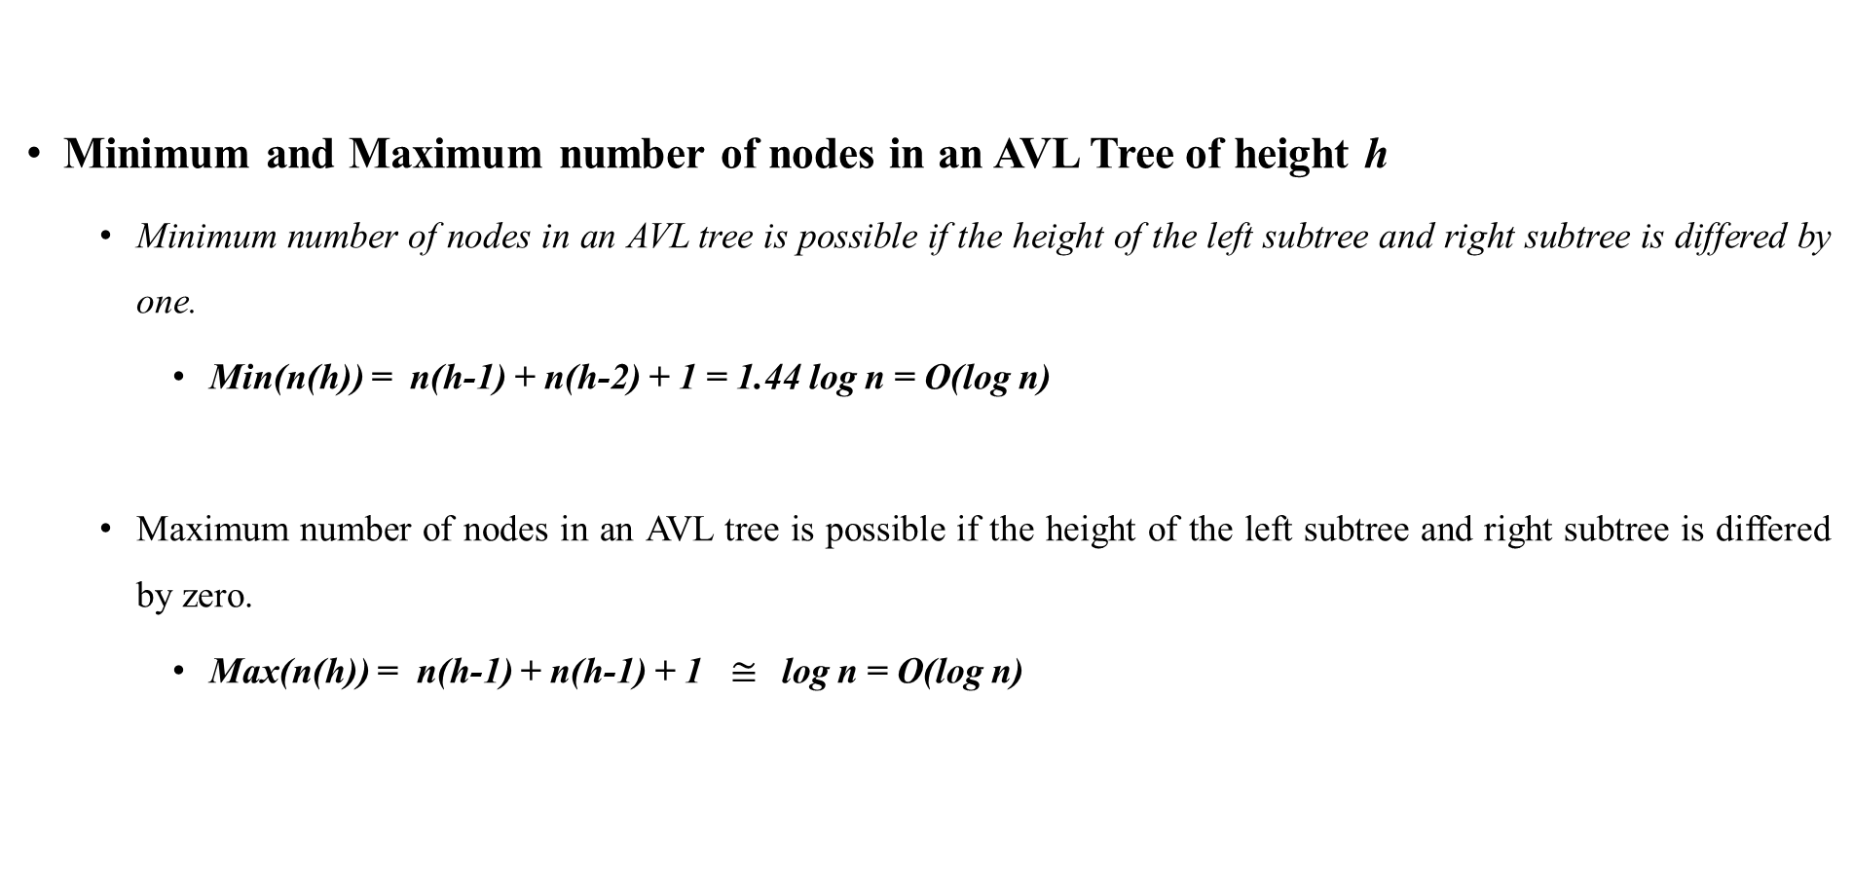
AVL Trees
Minimum and Maximum number of nodes in an AVL Tree of height h
Minimum number of nodes in an AVL tree is possible if the height of the left subtree and right subtree is differed by one.
Min(n(h)) = n(h-1) + n(h-2) + 1 = 1.44 log n = O(log n)
Maximum number of nodes in an AVL tree is possible if the height of the left subtree and right subtree is differed by zero.
Max(n(h)) = n(h-1) + n(h-1) + 1 $≅$log n = O(log n)
A
B
C
D
A
B
C
D
E
F

Slide 68
AVL Tree - Declaration
AVL Tree declaration
typedef struct AVLTree AVL;
struct AVLTree {
<data type> data;
AVL *left;
AVL *right;
int height; };
Insertion
AVL tree is similar to Binary Search Tree, so find the proper place for the new element as we do in the Binary Search Tree and insert the new element. But after insertion the possibility is that it may violate the balance factor.
So whenever after insertion there is a violation in balance factor then fix the size of the tree by rearranging the nodes.
Note: Always fix the first node that is not satisfying the AVL property on the path from the insertion point to the root.

Slide 69
AVL Tree - Insertion
Types of Violations
Let us assume the node that violates the AVL property on the path from the insertion point to the root is X. The following are the four types of possible violations:
Inserting a node into the left subtree of the left child of X (Case-1).
Inserting a node into the right subtree of the left child of X (case -2).
Inserting a node into the left subtree of the right child of X (case -3).
Inserting a node into the right subtree of the right child of X (case - 4).
These violations can be fixed using single rotation or using the double rotation

Slide 70
AVL Tree - Rotations
Single Rotations
Left – Left Rotation (LL – rotation to solve case -1)
Consider the following AVL Tree
A new node is inserted into the left subtree of the left child of Y, Violation happened at node X;
That is height of the left subtree is h + 2 and height of the right subtree of X is h, so the balance factor k = 2.
k = 2
X
k = 1
Y
k = 0
C
B
A

Slide 71
AVL Tree - Rotations
Single Rotations
Left – Left Rotation (LL – rotation to solve case -1)
Consider the following AVL Tree
Reduce the height of the left tree of X by one by increasing the height of right subtree of X to one.
k = 1
Y
k = 2
X
A
X
k = 1
Y
k = 0
C
B
C
B
A

Slide 72


AVL Tree - Rotations
Single Rotations
Left – Left Rotation (LL – rotation to solve case -1) Example
Consider the following AVL Tree (new element inserted is 1)
The violations happened at node element 5, do the L-L rotation
8
8
5
12
3
12
19
2
5
19
3
6
2
1
3
4
6
4
1

Slide 73
AVL Tree – L-L Insertion pseudo code
L-L rotation
Traverse from the inserting node position to the node where the AVL property violated and in the path update all the heights of the node by increasing to one. Call the following code at node X,
AVL *LL_Rotation(AVL *X)
{ AVL *T = X –> left;
X → left = *T → right;
X → height = MAX(X→left→height, X→right→height) + 1;
T → height = MAX(T→left→height, X→height) + 1;
return T;
};
Time Complexity - O(1) and Space Complexity – O(1)
Y
X
A
X
Y
C
B
C
B
A

Slide 74
AVL Tree - Rotations
Single Rotations
Right – Right Rotation (RR – rotation to solve case - 4)
Consider the following AVL Tree
A new node is inserted to the right subtree of the right child of X, violation happened at node X;
That is height of the right subtree is h + 2 and height of the left subtree of X is h, so the balance factor k = 2 at node X.
X
k = 2
k = 1
C
k = 1
Y
B
A

Slide 75
AVL Tree - Rotations
Single Rotations
Right – Right Rotation (RR – rotation to solve case - 4)
Consider the following AVL Tree
Reduce the height of the right tree of X by one by increasing the height of left subtree of X to one
Y
X
k = 2
X
A
k = 1
C
k = 1
Y
C
B
B
A

Slide 76



AVL Tree - Rotations
Single Rotations
Right – Right Rotation (RR – rotation to solve case - 4) Example
Consider the following AVL Tree (new element inserted is 1)
The violations happened at node element 12, do the R-R rotation
12
8
8
19
6
12
6
11
17
21
3
11
19
5
23
17
21
23

Slide 77
AVL Tree – L-L Insertion pseudo code
L-L rotation
Traverse from the inserting node position to the node where the AVL property violated and in the path update all the heights of the node by increasing to one. Call the following code at node X,
AVL *LL_Rotation(AVL *X)
{ AVL *T = X –> right;
X → right = T→ left;
T → left = X;
X → height = MAX(X→left→height, X→right→height) + 1;
T → height = MAX(T→right→height, X→height) + 1;
return T;
};
Time Complexity - O(1) and Space Complexity – O(1)
Y
X
X
A
C
Y
C
B
B
A

Slide 78
AVL Tree - Rotations
Double Rotations
Left – Right Rotation (LR – rotation to solve case - 2) – Required two rotations
Consider the following AVL Tree (new node is inserted in the right subtree of the left child of X). AVL violations at node X.
X
Do the right rotation at Y
X
Z
Y
B
Do the Left rotation at X
Z
B
X
A
Z
Y
Y
D
D
A
C
B
C
D
A
C
Time Complexity - O(1) and Space Complexity – O(1)

Slide 79




AVL Tree - Rotations
Double Rotations
Left – Right Rotation (LR – rotation to solve case - 2) – Example
8
6
Do the right rotation at 4
8
4
9
4
6
9
Do the Left rotation at 6
8
3
6
4
3
9
7
7
7
3

Slide 80
AVL Tree - Rotations
Double Rotations
Right – Left Rotation (RL – rotation to solve case - 3) – Required two rotations
Consider the following AVL Tree (new node is inserted in the left subtree of the right child of X). AVL violations at node X.
Z
X
X
Do the left rotation at Y
X
Y
B
Y
B
Z
Do the Right rotation at Z
B
C
A
D
A
Z
C
Y
C
D
A
D
Time Complexity - O(1) and Space Complexity – O(1)

Slide 81
ASSIGNMENT
Write the pseudo code for constructing a AVL tree for a given n elements.

Slide 82
B-Trees
Acknowledgement – I took this explanation from the book “Data structures and algorithm analysis in C”, by Mark Allenweis
B-Trees are the search trees which are not binary (BST and AVL are binary trees).
A B-Tree of order M is a tree with the following structural properties:
The root is either a leaf or has between 2 and M children.
All non leaf nodes except the root node have between ceil(M/2) to M children.
All leaves are at the same depth.
All the internal nodes are pointers P₁, P₂, …., P_{M} to the children, and values k₁, k₂, k₃, …. k_{M-1,} representing the smallest key found in the subtrees P₁, P₂, ….., P_{M,} respectively. Some of these pointers are NULL. All the key values in the subtree P₁ are smaller then the keys in the sub tree P₂, and so on.

Slide 83
B-Trees
There are many definitions of B-Trees that change the structure in minor ways but the definition was one of the standard one.
Internal node structure of the B-Tree of order 3
A B-Treen of order 4 is popularly known as 2-3-4 tree and a B-Tree of order 3 is known as 2-3 tree.
P₁ | k₁ | P₂ | k₂ | P₃

Slide 84
B-Trees
Consider the following 3 order B-Tree
(Internal nodes are represented using the ellipse and the leaf nodes are represented as rectangles)
Insert the key 18 - Find the place for 18 and if it does not violate the B-Tree properties add it to it
22: -
16: -
41: 58
8, 11, 12
16, 17
22, 23, 31
41, 52
58, 59, 61

Slide 85


B-Trees
After inserting 18,
Insert 1 → Its position is in the left most rectangle and is already filled with the maximum number of keys.
Solution → Make two nodes of two keys each and adjusting the information in the parent.
22: -
16: -
41: 58
8, 11, 12
16, 17, 18
22, 23, 31
41, 52
58, 59, 61

Slide 86





B-Trees
After inserting 1,
Insert 19 → The above mentioned idea does not work
Solution → One simple solution is split the three key elements child node into two and make two keys in each node. Splitting it would create a problem to its parent, but we can keep on splitting nodes on the way up to the root until we either get to the root or find a node with only two children.
22: -
11 : 16
41: 58
1, 8
11, 12
16, 17, 18
22, 23, 31
41, 52
58, 59, 61

Slide 87





B-Trees
After inserting 19,
You try to insert 28 (the number levels will be increased to one)
22: -
11 : -
18 : -
41: 58
16, 17
18, 19
22, 23, 31
41, 52
58, 59, 61
1, 8
11, 12

Slide 88
B-Trees
Deletion
We can perform deletion by finding the key to be deleted and removing it.
If this key was only one of the two keys in a node, then its removal leaves only one key.
We can fix this by combining this node with the a sibling.
If the sibling has only two keys, we combine the two nodes into a single node with three keys.
The parent of this node now looses a child, so we might have percolate this strategy all the way to the top.
If the root looses its second child, then the root is also deleted and the tree becomes one level shallower.
As we combine the nodes, we must remember to update the information kept at the internal nodes.

Slide 89


B-Trees
The depth of the B-Tree is at most ceil(log_{ceil(M/2)} N).
At each node on the path we perform O(log M) work to determine which branch to take, but Insert or Delete could require O(M) work to fix up all the information at the node.
The worst case running time for each of the insertion or deletion operation is thus O(M log_{M} N)
Find operation takes only O(log N) time.

Slide 90
GRAPHS (Acknowledgement - Most of the explanations for graphs I took it from the following text book: “Data Structures and Algorithm Analysis in C”, by Mark Allen Weiss)

Slide 91
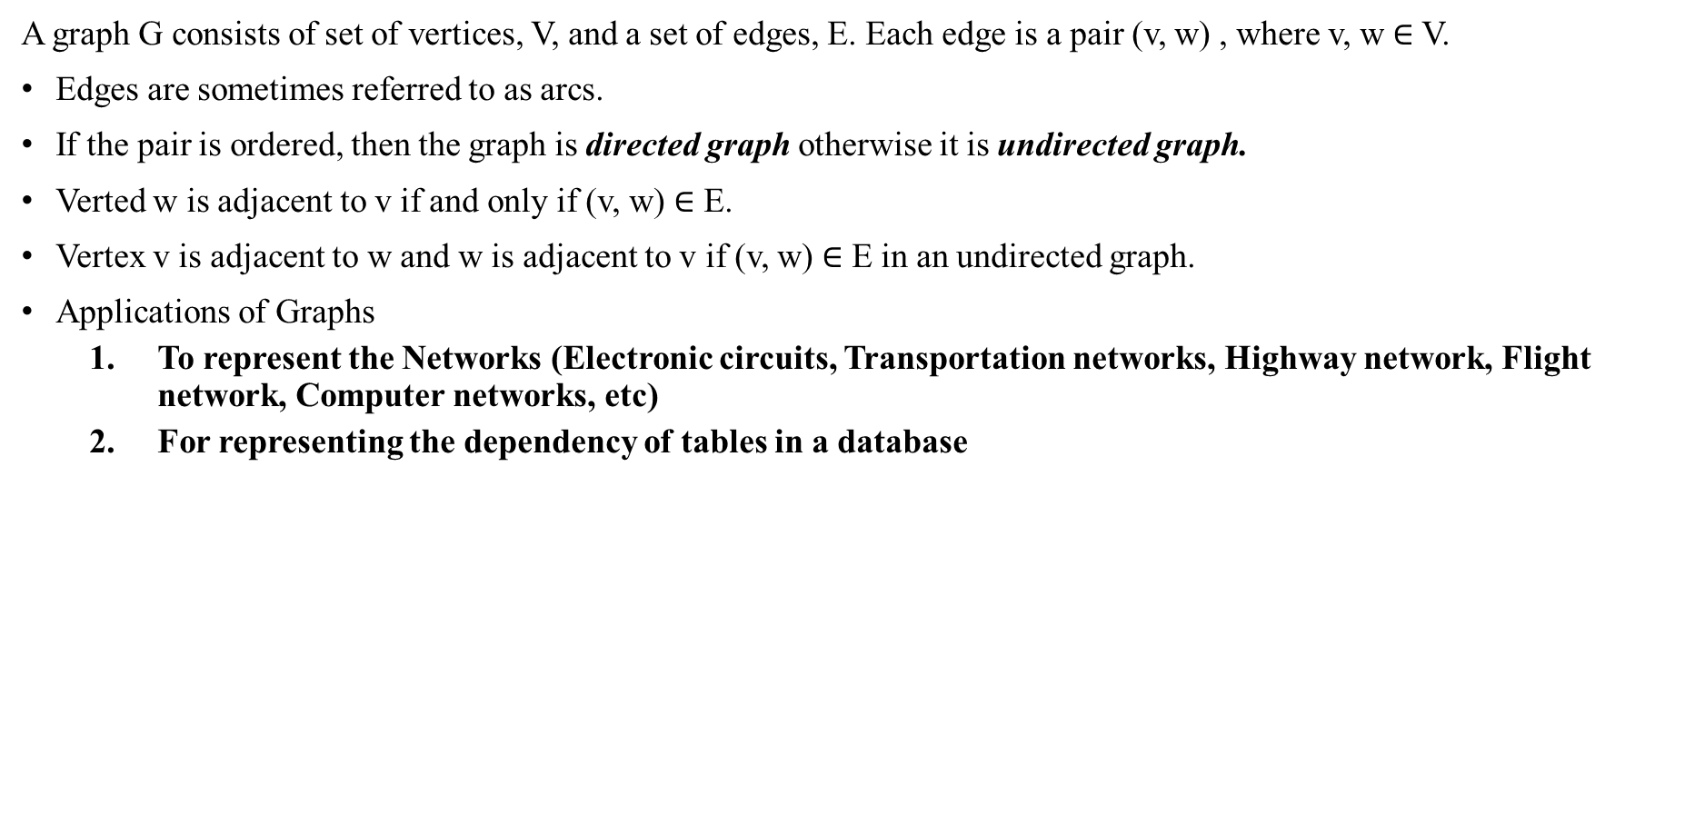
Graphs
A graph G consists of set of vertices, V, and a set of edges, E. Each edge is a pair (v, w) , where v, w $∈$ V.
Edges are sometimes referred to as arcs.
If the pair is ordered, then the graph is directed graph otherwise it is undirected graph.
Verted w is adjacent to v if and only if (v, w) $∈$ E.
Vertex v is adjacent to w and w is adjacent to v if (v, w) $∈$ E in an undirected graph.
Applications of Graphs
To represent the Networks (Electronic circuits, Transportation networks, Highway network, Flight network, Computer networks, etc)
For representing the dependency of tables in a database
1
2
2
6
3
1
3
5
4
4
Undirected Graph
G = ({1, 2, 3, 4, 5, 6}, { (1, 2), (2, 3), (3, 4), (4, 5), (5, 6), (6, 1), (6, 3)} )
Directed Graph
G = ({1, 2, 3, 4}, {(1, 2), (2, 4), (4, 3), (3, 2), (4, 1)} )

Slide 92
Graphs
A graph with no cycles is called tree.
A self loop is and edge that connects a vertex to itself.
Two edges are parallel if they connect the same pair of vertices.
The degree of a vertex is the number of edges incident to it.
A subgraph is a subset of graphs edges that forma graph.
A path is a sequences of adjacent vertices.
Simple path is a path with no repeated vertices.
A cycle is a path where the first and last vertices are the same.
A graph is connected if there is a path from every vertex to every other vertex.
If a graph is not connected then it consists of a set of connected components.
A directed acyclic graph (DAG) is a directed graph with no cycles.
Some times an edge has a third component, known as either weight or cost.

Slide 93
Representation of Graphs
Graphs are represented using the following approaches
Adjacency Matrix – A matrix of size n X n is maintained, where n is the number of vertices. If there is an edge from vertex v to vertex w then adj_Mat[v, w] = 1, if it is a unweighted graph, otherwise fill with the cost of the edge. If there is no edge between v and w then set the value to 0. (Used in dense graphs – Number of edges closed to the maximum possible number of edges)
Adjacency List - In this representation all the vertices connected toa vertex v are listed on an adjacency list for that vertex v. (Used in sparse graphs – Graphs with only fewer edges)
Adjacency Set – Similar to adjacency list but instead of using the Linked Lists Disjoint sets are used.

Slide 94
Representation of Graphs
Example – Consider the following graph
Adjacency matrix: Adjacency List:
2
1
3
4
 | 1 | 2 | 3 | 4
1 | 0 | 1 | 0 | 0
2 | 0 | 0 | 0 | 0
3 | 0 | 1 | 0 | 0
4 | 1 | 0 | 1 | 0
1
2
3
4
2
4
2
1
3

Slide 95
Representation of Graphs
Representation | Space | Checking Edge between v and w | Iterate over edges incident to v ?
Adjacency List | O(E + V) | Degree(v) | E
Adjacency Matrix | O(V²) | O(1) | V
Adjacency Set | O(E + V) | log(Degree(v)) | Degree(v)

Slide 96
Graph Traversals
To work with the graphs we need a mechanism to visit the nodes in the graph, there exist two popular techniques for traversing the graphs:
Depth First Search (DFS)
Breadth First Search (BFS)

Slide 97
DFS Traversal
DFS works similar to the pre-order traversal technique of the tree. It works in the following manner
“Starting at some vertex, v, we process v and then recursively all the vertices adjacent to v. To avoid cycles we need to remember which nodes are visited.”
By starting at vertex v it considers the edges from v to other vertices.
If the edge leads to an already visited vertex, then backtrack to the current vertex v.
If an edge leads to unvisited vertex, then go to that vertex and start processing that vertex.
The new vertex becomes the current vertex.
Follow this procedure until we reach dead-end. At this point do the backtracking.

Slide 98

DFS Traversal
Void DFS(Vertex v)
{ visited[v] = true;
for each w adjacent to v
{ if (!visited[w])
{ DFS(w); }
}
}// Here visited is an array with size |V| and all are initialized to false
Time Complexity O( |E| + |V|)
If we apply DFS on the graph shown here with a vertex 1 then, it results the following order of visiting nodes: <1> <2> <4> <3> <5>
Another possible DFS order is: <1> <2> <3> <5> <4>
DFS uses stack data structure
2
1
3
4
5

Slide 99
BFS Traversal
DEF works similar to the Level-order traversal technique of the tree. It works in the following manner
“Starting at some vertex, which is at level 0. We process v and then process all the vertices at level (vertices whose distance is one from the start vertex). In the second stage it process all the vertices in level 2 (these are vertices which are adjacent to level one). This process is continued till all the levels are processed. To avoid cycles we need to remember which nodes are visited.”
BFS uses queue data structure.

Slide 100

BFS Traversal
Void BFS(Vertex v)
{ Enqueue(Queue, v);
if(Queue is not empty)
{ Vertex u = Dequeue(Queue);
visited[u] = True;
for each w adjacent to u
{ if (!visited[w])
{ Enqueue(Queue, w); }
}
}// Here visited is an array with size |V| and all are initialized to false initially.
Time Complexity O( |E| + |V|)
If we apply BFS on the graph shown here with a vertex 1 then, it results the following order of visiting nodes: <1> <2> <4> <3> <5>
Another possible BFS order is: <1> <2> <3> <4> <5>
2
1
3
4
5

Slide 101
BFS and DFS
Applications of DFS
Topological sorting
Finding connected components
Finding the articulation points (Cut vertices of the graph)
Finding the strongly connected components
Solving puzzles such as mazes
Applications of BFS
Finding all connected components in a graph
Finding the nodes with in one connected component
Finding the shortest path between nodes
Testing graph for bipartiteness

Slide 102
Topological Sorting
“A topological sort is an ordering of vertices in a directed acyclic graph, such that if there is a path from u to v, then v appears after u in the ordering.”
Procedure: Input a Graph G = (V, E) // Directed one
Output: The topological ordering of vertices in G.
Compute the indegree of all the vertices. Set a counter to 0.
Find the vertices whose indegree is zero and push them into a queue.
If the queue is empty then Display an error and stop the algorithm.
Dequeue the vertex from queue and call it as v.
Output v and decrease the indegree of all vertices u, where u has an incoming edge from v (v and u are adjacent). If the indegree of u is zero then enqueue it into queue.
Increment the counter. Repeat steps 3 and 5 if the counter is less than the number of vertices.

Slide 103
Topological Sorting
Example: Consider the following DAG (from the Mark Allen Weiss text book)
V₁
V₂
Vertex | Indegree before Dequeue
v₁ | 0 | 0 | 0 | 0 | 0 | 0 | 0
v₂ | 1 | 0 | 0 | 0 | 0 | 0 | 0
v₃ | 2 | 1 | 1 | 1 | 0 | 0 | 0
v₄ | 3 | 2 | 1 | 0 | 0 | 0 | 0
v₅ | 1 | 1 | 0 | 0 | 0 | 0 | 0
v₆ | 3 | 3 | 3 | 3 | 2 | 1 | 0
v₇ | 2 | 2 | 2 | 1 | 0 | 0 | 0
Enqueue | v₁ | v₂ | v₅ | v₄ | v₃, v₇ |  | v₆
Dequeue | v₁ | v₂ | v₅ | v₄ | v₃ | v₇ | v₆
v₃
v₄
v₅
v₆
v₇

Slide 104



Topological Sorting
“A topological sort is an ordering of vertices in a directed acyclic graph, such that if there is a path from u to v, then v appears after u in the ordering.”
Void Topsort(Graph G)
{ int counter; Vertex v, w;
for (counter =0; counter < NumberOfVertices; counter++) // Process |V| vertices
{ v = FindNewVertexofDegreeZero();
if (v is not a vertex) { Display (“ERROR”); exit() }
TopNum[v] = counter; // The position of v is counter
for each w adjacent to v
{ Indegree [w] --; }
}
}
Time complexity : O(|V|²) (when searching for a vertex which has indegree zero in an array which maintains the indegree of vertices)
: O(|E| + |V|) (when we maintain the vertices whose indegree is zero separately in a new data structure (queue or stack) )

Slide 105
Topological Sorting
Applications of Topological Sorting
Representing course prerequisite
Detecting deadlocks
Pipeline of computing jobs
Checking for symbolic link loop
Evaluating formulae in spreadsheet

Slide 106
Shortest-Path Algorithms
Single Source Shortest Path Algorithm - Given an input weighted graph, G = (V, E), and a distinguished vertex, s, find the shortest weighted path from s to every other vertex in G.
The shortest path from vertex v₁ to v₆ has a cost of 6, and goes from v₁ to v₄ to v₇ to v₆.
In real life we have many applications where we want to solve the shortest-path problems. If the vertices are computers; edges are the link between computers; and the cost represents communication costs, delay costs, or combination of these two or other factors.
Finding the shortest route between two cities.
V₁
2
V₂
4
1
3
10
v₃
2
v₄
2
v₅
5
8
4
6
v₆
1
v₇

Slide 107
Shortest-Path Algorithms
If the graph is unweighted one, we can apply the breadth first search to solve the single source shortest path.
Consider V₁ is the source vertex, apply BFS, we will get the following sequence
V₁ → {V_{2,} V₄} → {V₅, V₆, V₇, V₃}
Will it work for a Weighted Graph?
Yes (if the cost of the edge is 3, then replace three edges), but graph has too many vertices.
V₁
V₂
v₃
v₄
v₅
v₆
v₇

Slide 108
Dijkstra’s Algorithm
It works on the algorithm design technique Greedy Method -
It work in phases.
In each phase, a decision is made that appears good, without regard for future consequences. Generally this means that some local optimum is chosen. This is “take what you get now” strategy is the source of the name for this class of algorithms.
When the algorithm terminates we hope the local optimum is equal to the global optimum. If this is the case the algorithm is correct, otherwise it produces a suboptimal solution.

Slide 109
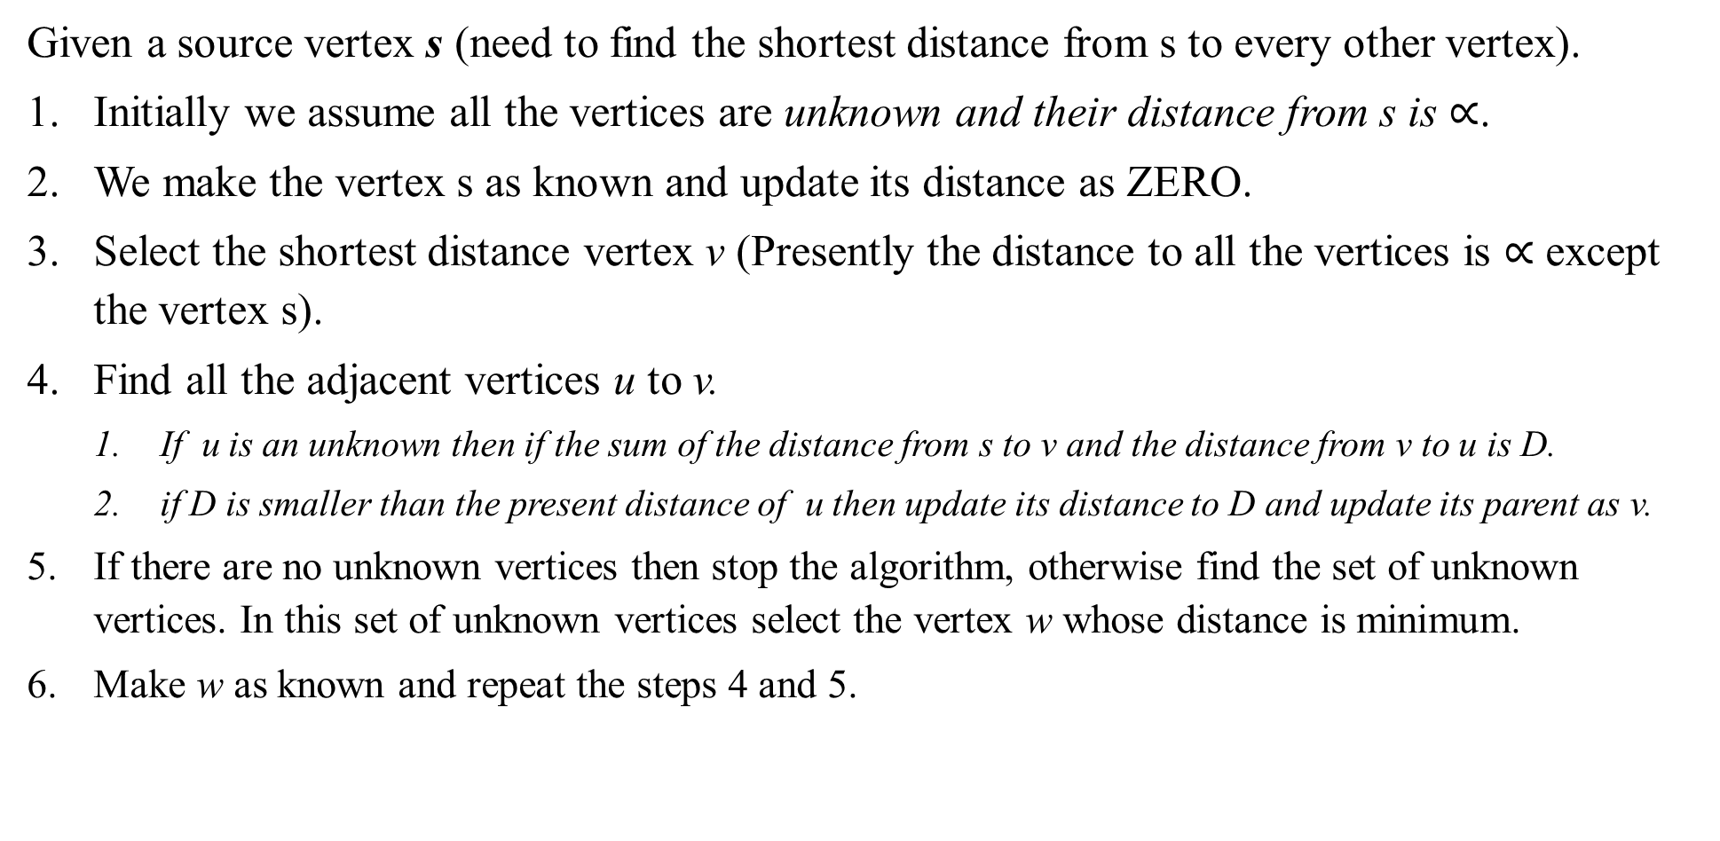
Dijkstra’s Algorithm
Given a source vertex s (need to find the shortest distance from s to every other vertex).
Initially we assume all the vertices are unknown and their distance from s is $∝$.
We make the vertex s as known and update its distance as ZERO.
Select the shortest distance vertex v (Presently the distance to all the vertices is $∝$ except the vertex s).
Find all the adjacent vertices u to v.
If u is an unknown then if the sum of the distance from s to v and the distance from v to u is D.
if D is smaller than the present distance of u then update its distance to D and update its parent as v.
If there are no unknown vertices then stop the algorithm, otherwise find the set of unknown vertices. In this set of unknown vertices select the vertex w whose distance is minimum.
Make w as known and repeat the steps 4 and 5.
V₁
2
V₂
4
1
3
10
v₃
2
v₄
2
v₅
5
8
4
6
v₆
1
v₇

Slide 110
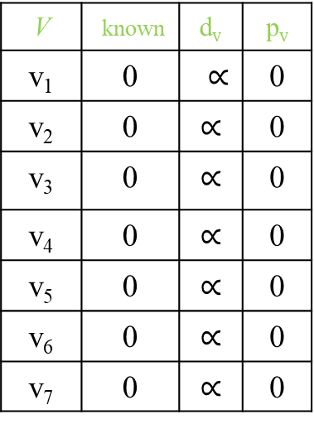

Dijkstra’s Algorithm
To apply the algorithm we use the following data structure:
The first column represents the list of vertices.
Second column remembers which vertices shortest distance is already found (0 is unknown and 1 indicates known)
Third column indicates the shortest distance from the source vertex (initially all the vertices are in $∝$ distance)
Fourth column records its predecessor node in the path found to reach this node from source vertex.
V | known | d_{v} | p_{v}
v₁ | 0 | $∝$ | 0
v₂ | 0 | $$∝$$ | 0
v₃ | 0 | $$∝$$ | 0
v₄ | 0 | $$∝$$ | 0
v₅ | 0 | $$∝$$ | 0
v₆ | 0 | $$∝$$ | 0
v₇ | 0 | $$∝$$ | 0
V₁
2
V₂
4
1
3
10
v₃
2
v₄
2
v₅
5
8
4
6
v₆
1
v₇

Slide 111


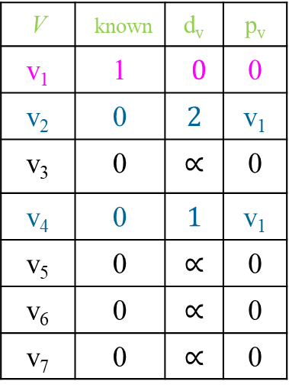






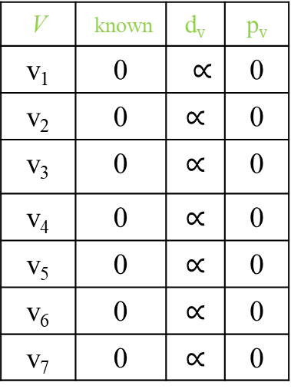




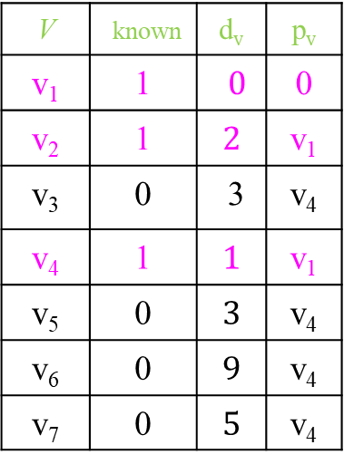





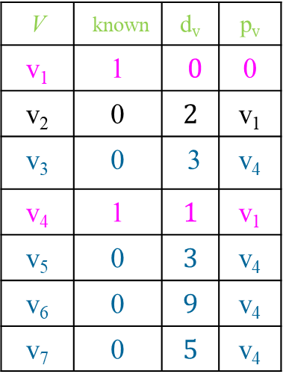





Dijkstra’s Algorithm
V₁
2
V₂
Initial configuration
After making v₁ as known vertex
After making v₄ as known vertex
After making v₂ as known vertex
4
1
3
10
v₃
2
v₄
2
v₅
5
8
4
6
V | known | d_{v} | p_{v}
v₁ | 0 | $∝$ | 0
v₂ | 0 | $$∝$$ | 0
v₃ | 0 | $$∝$$ | 0
v₄ | 0 | $$∝$$ | 0
v₅ | 0 | $$∝$$ | 0
v₆ | 0 | $$∝$$ | 0
v₇ | 0 | $$∝$$ | 0
v₆
1
v₇
V | known | d_{v} | p_{v}
v₁ | 1 | $0$ | 0
v₂ | 0 | $$2$$ | v₁
v₃ | 0 | $$∝$$ | 0
v₄ | 0 | $$1$$ | v₁
v₅ | 0 | $$∝$$ | 0
v₆ | 0 | $$∝$$ | 0
v₇ | 0 | $$∝$$ | 0
V | known | d_{v} | p_{v}
v₁ | 1 | $0$ | 0
v₂ | 0 | $$2$$ | v₁
v₃ | 0 | 3 | v₄
v₄ | 1 | $$1$$ | v₁
v₅ | 0 | $$3$$ | v₄
v₆ | 0 | $$9$$ | v₄
v₇ | 0 | $$5$$ | v₄
V | known | d_{v} | p_{v}
v₁ | 1 | $0$ | 0
v₂ | 1 | $$2$$ | v₁
v₃ | 0 | 3 | v₄
v₄ | 1 | $$1$$ | v₁
v₅ | 0 | $$3$$ | v₄
v₆ | 0 | $$9$$ | v₄
v₇ | 0 | $$5$$ | v₄

Slide 112






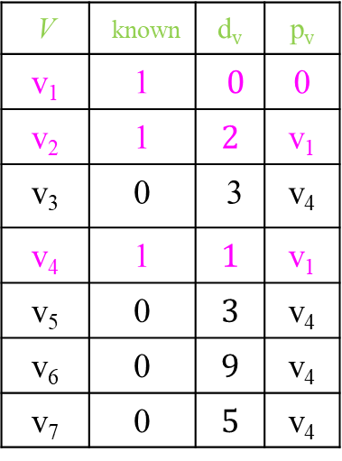






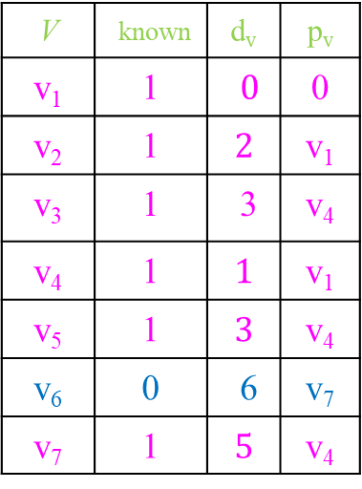







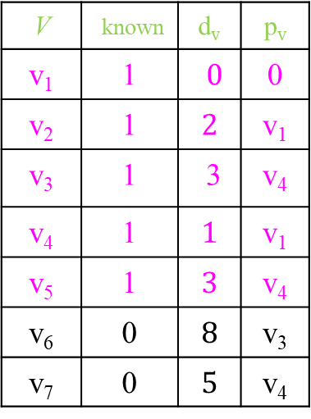





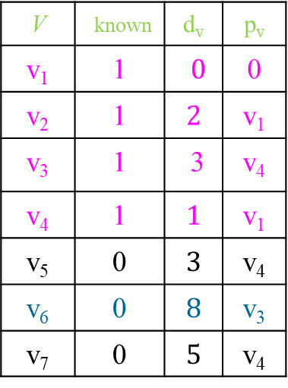




Dijkstra’s Algorithm
V₁
2
V₂
After making v₂ as known vertex
After making v₃ as known vertex
After making v₅ as known
After making V₇ as known
4
1
3
10
v₃
2
v₄
2
v₅
V | known | d_{v} | p_{v}
v₁ | 1 | $0$ | 0
v₂ | 1 | $$2$$ | v₁
v₃ | 0 | 3 | v₄
v₄ | 1 | $$1$$ | v₁
v₅ | 0 | $$3$$ | v₄
v₆ | 0 | $$9$$ | v₄
v₇ | 0 | $$5$$ | v₄
5
8
4
6
v₆
1
v₇
V | known | d_{v} | p_{v}
v₁ | 1 | $0$ | 0
v₂ | 1 | $$2$$ | v₁
v₃ | 1 | 3 | v₄
v₄ | 1 | $$1$$ | v₁
v₅ | 0 | $$3$$ | v₄
v₆ | 0 | $$8$$ | v₃
v₇ | 0 | $$5$$ | v₄
V | known | d_{v} | p_{v}
v₁ | 1 | $0$ | 0
v₂ | 1 | $$2$$ | v₁
v₃ | 1 | 3 | v₄
v₄ | 1 | $$1$$ | v₁
v₅ | 1 | $$3$$ | v₄
v₆ | 0 | $$8$$ | v₃
v₇ | 0 | $$5$$ | v₄
V | known | d_{v} | p_{v}
v₁ | 1 | $0$ | 0
v₂ | 1 | $$2$$ | v₁
v₃ | 1 | 3 | v₄
v₄ | 1 | $$1$$ | v₁
v₅ | 1 | $$3$$ | v₄
v₆ | 0 | 6 | v₇
v₇ | 1 | $$5$$ | v₄

Slide 113


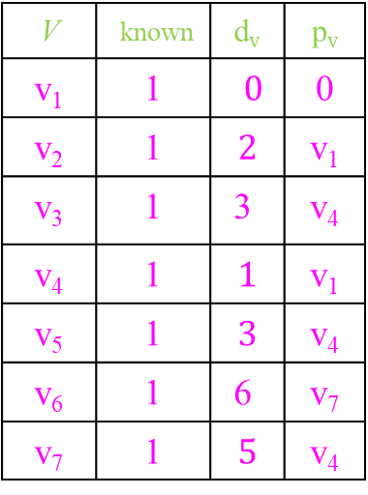






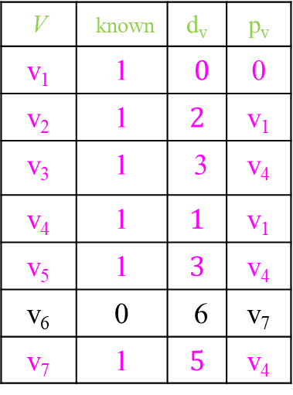














Dijkstra’s Algorithm
V₁
2
V₂
:
After making v₇ as known vertex
After making v₆ as known vertex
How to find the shortest path to v₆ from v₁ ?
v₆ ← v₇ ← v₄ ← v₁
4
1
3
10
v₃
2
v₄
2
v₅
V | known | d_{v} | p_{v}
v₁ | 1 | $0$ | 0
v₂ | 1 | $$2$$ | v₁
v₃ | 1 | 3 | v₄
v₄ | 1 | $$1$$ | v₁
v₅ | 1 | $$3$$ | v₄
v₆ | 0 | 6 | v₇
v₇ | 1 | $$5$$ | v₄
5
8
4
6
v₆
1
v₇
V | known | d_{v} | p_{v}
v₁ | 1 | $0$ | 0
v₂ | 1 | $$2$$ | v₁
v₃ | 1 | 3 | v₄
v₄ | 1 | $$1$$ | v₁
v₅ | 1 | $$3$$ | v₄
v₆ | 1 | 6 | v₇
v₇ | 1 | $$5$$ | v₄

Slide 114
Dijkstra’s Algorithm (psuedo code)
Void Dijkstra (Table T)
{ Vertex v, w;
for( ; ; )
{ v = smallestUnknownDistanceVertex; // |V| in one iteration (there are |V| iterations (if we use arrays)
if(v == Not A Vertex)
break;
T[v].known = True;
for each w adjacent to v // |E| (total cost in all iterations)
{ if(! T[w].known)
{ if T[v].Dist + C_{vw} < T[w].Dist)
{ Decrease (T[w]. Dist to T[v].Dist + C_{vw});
T[w]. Path = v;
}
}
}
}
}
Time Complexity = O(|V|² + |E| ) = O(|V|² ) // if we use an array to store the vertices distances in an array
Time Complexity = O( |V| log|V| + |E| log|V|) = O(||E| log |V|) // if we use priority queue

Slide 115
Bellman – Ford Algorithm
Limitation of Dijkstra’s algorithm
It may not work if any edge has a negative cost.
Applying the Dijkstra algorithm from the source vertex 1,
The cost of the shortest distance to the vertex 3 is 4 (1 → 3),
The cost of shortest distance to vertex 2 is 5 (1→ 2).
But the actual cost to vertex 3 is 2 (1 → 2 → 3)
Observation – Once any vertex is made as known, Dijkstra’s algorithm will not update that vertex
1
5
2
-3
4
3

Slide 116

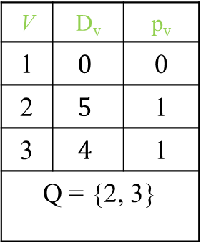





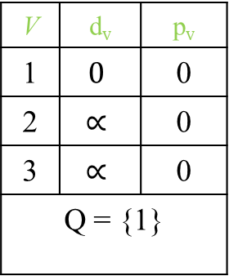


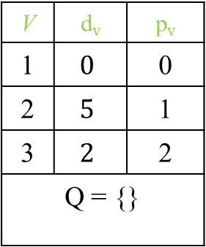




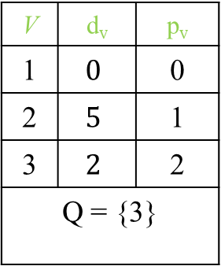


Bellman – Ford Algorithm
Idea - Create a queue and insert source vertex s into the queue. Dequeue a vertex from Queue and assume it is v. Find all vertices w adjacent vertices to v. If the distance to v from s and the distance from v to w is less than the present distance to w then update the distance ( update its parent also) and enqueue w if it is not in the queue.
Repeat this procedure until there are vertices in Queue.
Example:
Assume source vertex is 1.
After dequeuing 1, After dequeuing 2, After deqeuing 3,
1
5
2
-3
4
3
V | d_{v} | p_{v}
1 | $$0$$ | 0
2 | $$∝$$ | 0
3 | $$∝$$ | 0
Q = {1}
V | D_{v} | p_{v}
1 | $$0$$ | 0
2 | $$5$$ | 1
3 | $$4$$ | 1
Q = {2, 3}
V | d_{v} | p_{v}
1 | $$0$$ | 0
2 | $$5$$ | 1
3 | $$2$$ | 2
Q = {3}
V | d_{v} | p_{v}
1 | $$0$$ | 0
2 | $$5$$ | 1
3 | $$2$$ | 2
Q = {}

Slide 117

Bellman – Ford (pseudo code)
Void Dijkstra (Table T)
{ Queue Q; Vertex v, w;
Enqueu(Q, s) // s is the source vertex
while (!IsEmpty(Q))
{ v = Dequeue(Q);
for each w adjacent to v
{ if T[v].Dist + C_{vw} < T[w].Dist)
{ Decrease T[w]. Dist to T[v].Dist + C_{vw};
T[w]. Path = v;
if w is not already in Q
{ Enqueu(Q, w); }
}
}
}
}
Time Complexity = O( |E| . |V|)
Note: Algorithm works if is no negative – cycle;

Slide 118
Minimum Spanning Tree
Minimum Spanning Tree (MSP) – Minimum Spanning Tree of an undirected graph G is a tree formed from graph edges that connects all the vertices of G at lowest total cost.
MSP exists if and only if the graph is connected.
Example :
Spanning Tree but not MSP
MSP for the above graph (cost is 6):
1
5
2
1
5
2
4
4
3
1
3
4
2
2
3
4
1
2
3
1
2
3
4

Slide 119
Minimum Spanning Tree
The following are the two algorithms exist to find the MSPs :
Prims Algorithm
Kruskal Algorithm
Both these algorithms works on the principle of Greedy Techniques

Slide 120
Prims Algorithm
Idea of Prims Algorithm- “Grow the tree in successive stages. In each stage, one node is picked as the root, and we add an edge, and thus an associated vertex, to the tree. At each stage, a new vertex added to the tree by choosing an edge (u, v) such that the cost of (u, v) is the minimum among all edges where u is in the tree and v is not.”

Slide 121

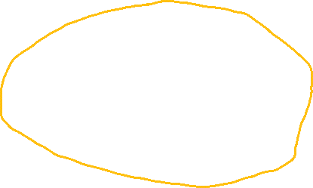







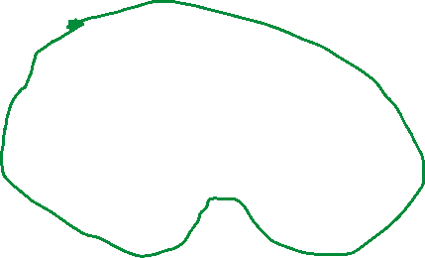
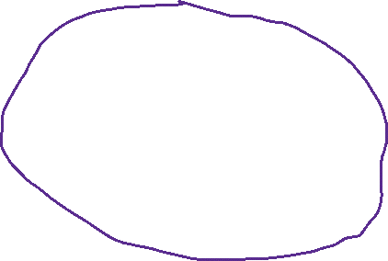





Prims Algorithm
V₁
2
V₂
4
1
3
10
v₃
2
v₄
7
v₅
Example
5
8
4
6
v₆
1
v₇
V₁
V₂
V₁
V₂
1
1
v₃
v₄
v₅
v₃
v₄
v₅
v₆
v₇
v₆
v₇
2
V₁
2
V₂
V₁
V₂
1
3
1
v₃
2
v₄
v₅
v₃
2
v₄
v₅
v₆
v₇
v₆
v₇

Slide 122




























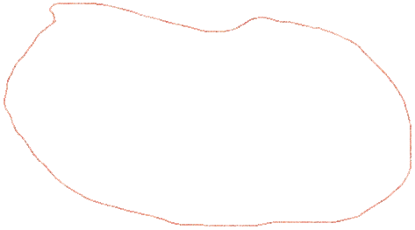





Prims Algorithm
V₁
2
V₂
4
1
3
10
v₃
2
v₄
7
v₅
Example
5
8
4
6
v₆
1
v₇
V₁
2
V₂
2
1
V₁
V₂
5
1
v₃
2
v₄
v₅
2
v₃
v₄
v₅
4
4
v₆
v₇
v₆
1
v₇
6
4
V₁
2
V₂
V₁
2
V₂
1
1
2
v₃
v₄
v₅
v₃
2
v₄
v₅
4
6
v₆
1
v₇
v₆
v₇

Slide 123


Prims Algorithm
Prims algorithm is essentially identical to Dijkstra’s algorithm. The only difference is that in the update rule.
Update rule: After v is selected, for each unknown w adjacent to v,
d_{w} = min (d_{w} , C_{w,v})
The time complexity is O(|V|²) without heaps and O(|E| log|V|) using binary heaps.

Slide 124
Disjoint Set ADT (Most of the explanations for graphs I took it from the following text book: “Data Structures and Algorithm Analysis in C”, by Mark Allen Weiss)

Slide 125
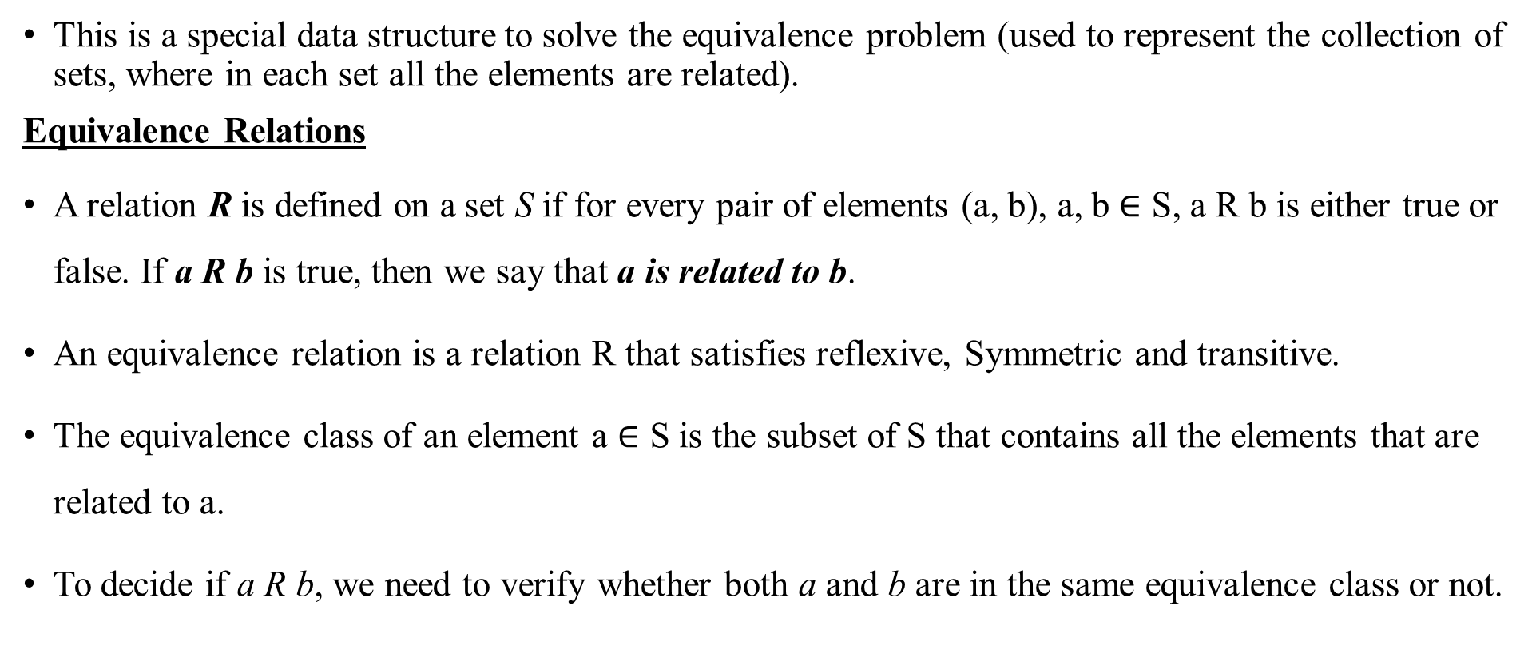
Disjoint set ADT
This is a special data structure to solve the equivalence problem (used to represent the collection of sets, where in each set all the elements are related).
Equivalence Relations
A relation R is defined on a set S if for every pair of elements (a, b), a, b $∈$ S, a R b is either true or false. If a R b is true, then we say that a is related to b.
An equivalence relation is a relation R that satisfies reflexive, Symmetric and transitive.
The equivalence class of an element a $∈$ S is the subset of S that contains all the elements that are related to a.
To decide if a R b, we need to verify whether both a and b are in the same equivalence class or not.

Slide 126
Disjoint set ADT
The input is initially a collection of N sets, each set with one element. This initial representation is that all relations (except reflexive relation) are false. Each set has a different element, so that S_{i}∩S_{j}=ɸ; this make the set disjoint.
There are two permissible operations:
Find – Returns the name of the set which contains the given element.
Union – Merges the two the equivalences classes contains a and b into a new equivalence class. From set point of view, the result of U is to create a new set S_{k} = S_{i} U S_{j}, destroying the original and preserving the disjointness of all the sets.
The algorithm to do this is frequently known as the disjoint set Union/Find algorithm for this reason.

Slide 127
Disjoint set ADT
Basic idea:
“Use a tree to represent each set and root can be used as the name of the set”
Initially, each set contains one element.
Assume that we used array P to represent tree;
Each entry in P[i] represents the parent of element i. If i is a root then P[i] = 0.
By making the root pointer of one node point to the root of another node for merging the two sets. Some times we need to merge on two elements, in this case we need to apply Find operation on these two elements to determine their roots..
The Find() operation on X returns the root of the X and it takes time proportional to the depth of the tree in the worst case O(N).

Slide 128

Disjoint set ADT
Void Initialize(DisjSet S)
{ int i;
for( i = NumSets; i > 0; i--) // NumSets is the number of sets initially, i.e., N
{ S[ i ] = 0; }
}
Void SetUnion(DisjSet S, SetType root1, setType root2) //Assume root1 and root2 are the roots of two trees
{ S[root2] = root1; }
Time complexity O(1)
SetType Find(ElementType X, DisjSet S)
{ if (S[X] <= 0) return X;
else return Find(S[X], S);
}
Time Complexity = O(log N)

Slide 129
Disjoint set ADT
Example: Apply union(e, f)
Consider the six elements a, b, c, d, e, f;
Initially each element is one set.
Apply Union(c, d) After applying the union(c, e)
a
b
c
e
0 | 0 | 0 | 0 | 0 | 0
d
f
0(a)
1(b)
2(c)
3(d)
4(e)
5(f)
0 | 0 | 0 | c | 0 | e
a
b
c
d
e
f
0(a)
1(b)
2(c)
3(d)
4(e)
5(f)
a
b
c
e
f
a
b
c
d
e
d
0 | 0 | 0 | c | 0 | 0
f
0(a)
1(b)
2(c)
3(d)
4(e)
5(f)
0 | 0 | 0 | c | c | e
0(a)
1(b)
2(c)
3(d)
4(e)
5(f)

Slide 130
Disjoint set ADT
After applying the union(c, e) After applying the union of (a, c) // or (a, d), or (a, f)
Observation –
We are blindly merging the set c with the set a, we can also merge the set a with set c. Why?
By merging set a with set c, the length of the tree will be 3 only. But merging the set c with set a the length of the tree is 4.
What is the result of Find(d)?
It returns a.
a
b
c
a
b
d
e
c
d
e
f
0 | 0 | 0 | c | c | e
f
0(a)
1(b)
2(c)
3(d)
4(e)
5(f)
0 | 0 | a | c | c | e
0(a)
1(b)
2(c)
3(d)
4(e)
5(f)

Slide 131
Disjoint set ADT
Union by Size (smart union)
Make the root of the larger tree as the new root and it guarantees that the depth of the tree at most log N.
So a sequence of M find operations takes O(M log N) time.
How do we incorporate the size of the tree?
Instead of zero maintain the size with a negative value (initially all the single node trees stores -1).
Union by height (smart union)
An alternative implementation is union by height, instead of merging the trees by size merge by height and it also guarantees the depth of the tree is at most log N.

Slide 132
Disjoint set ADT
Union by Size
Union by height
a
b
c
-1 | -1 | -4 | c | c | e
0(a)
1(b)
2(c)
3(d)
4(e)
5(f)
d
e
f
a
b
c
0 | 0 | -2 | c | c | e
0(a)
1(b)
2(c)
3(d)
4(e)
5(f)
d
e
f

Slide 133
Disjoint set ADT
Union by height
Void SetUnion(DisjSet S, SetType root1, setType root2) //Assume root1 and root2 are the roots of two trees
{ if (S[root2] < S[root1] // if root2 is deeper set (remember these are negative values
S[root1] = root2;
else
{ if(S[root2] == S[root1] // same height
S[root1]--; //increase the height
S[root2] = root1;
}
}
Time Complexity = O(1)

Slide 134
Kruskal Algorithm
Idea of Kruskal’s Algorithm- “It is also working on the principle of greedy; Continuously select the edges in order of smallest weight and accept an edge ifit does not cause a cycle”.
Formally, Kruskal’s algorithm maintains a forest – collection of trees. Initially, there are |V| single – node trees. Adding an edge merges two trees into one. When the algorithm terminates, there is only one tree, and this is the minimum spanning tree.

Slide 135
Kruskal Algorithm
Algorithm:
Sort all the edges in ascending order of their weight.
Select the smallest edge e.
Check if the inclusion of e forms a cycle or not with the spanning tree formed so far.
If cycle is not formed due to the inclusion of e, then include this edge, otherwise discard it.
Repeat step 2 to 4 until there are |V|-1 edges added to the spanning tree.

Slide 136











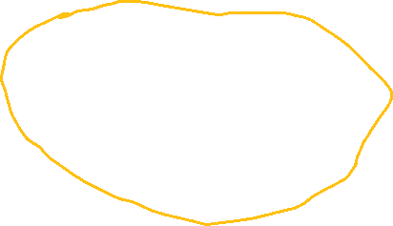






Kruskal’s Algorithm
V₁
2
V₂
4
1
3
10
v₃
2
v₄
7
v₅
Example
5
8
4
6
v₆
1
v₇
V₁
V₂
V₁
V₂
Edge | Weight | Action
(v₁, v₄) | 1 | Accepted
(v₆, v₇) | 1 | Accepted
(v₁, v₂) | 2 | Accepted
(v₃, v₄) | 2
(v₂, v₄) | 3
(v₁, v₃) | 4
(v₄, v₇) | 4
(v₃, v₆) | 5
(v₅, v₇) | 6
1
1
v₃
v₄
v₅
v₃
v₄
v₅
v₆
v₇
v₆
v₇
2
V₁
2
V₂
V₁
V₂
1
3
1
v₃
v₄
v₅
v₃
v₄
v₅
v₆
1
v₇
v₆
1
v₇

Slide 137




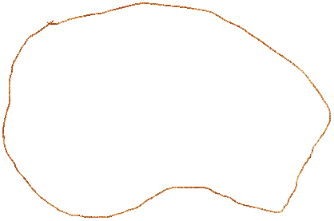

























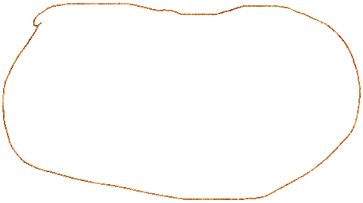

Kruska’s Algorithm
V₁
2
V₂
4
1
3
10
v₃
2
v₄
7
v₅
Example
5
8
4
6
v₆
1
v₇
V₁
2
V₂
2
1
V₁
V₂
1
Edge | Weight | Action
(v₁, v₄) | 1 | Accepted
(v₆, v₇) | 1 | Accepted
(v₁, v₂) | 2 | Accepted
(v₃, v₄) | 2 | Accepted
(v₂, v₄) | 3 | Rejected
(v₁, v₃) | 4 | Rejected
(v₄, v₇) | 4 | Accepted
(v₃, v₆) | 5 | Rejected
(v₅, v₇) | 6 | Accepted
2
5
v₃
v₄
v₅
v₃
2
v₄
v₅
4
v₆
1
v₇
v₆
1
v₇
6
4
V₁
2
V₂
V₁
2
V₂
1
1
2
v₃
v₄
v₅
v₃
v₄
v₅
4
6
v₆
1
v₇
v₆
1
v₇

Slide 138

Kruskal Algorithm
Void Kruskal(Graph G)
{ int EdgesAccepted = 0; DijSet S; PriorityQueue H; Vertex u, v; SetType Uset, Vset; Edge e;
Initialize(S);
ReadGraphIntoHeapArray(G, H); // Graph is in Adjacency matrix or adjacency matrix
BuildHeap(H); // Build the heap with respective to edges
while(EdgesAccepted < |V| -1)
{ e = DeleteMin(H); /* e = (u, v) */ // Delete the smallest edge (Complexity O(log |E|)
Uset = Find(u, S); // Find the root of u // O(log |E|)
Vset = Find(v, S); // Find the root of u // O(log |E|)
if(Uset != Vset)
{ EdgeAccepted++;
SetUnion(S, Uset, Vset); // Merge the Uset and Vset O(1)
}
}
}
Time Complexity = |E| (log |E| + log |E| + log |E|) = O(|E| log |E|)
Since |E| may be O(|V|²), in this case time complexity = O(|E| log |V|)

Slide 139
Tries Most of the explanations for graphs I took it from the following text book: “Algorithm Design (Foundations, Analysis, and Internet Examples)”, by Michael T. Goodrich, Roberto Tamassia)

Slide 140
Tries
Pattern Matching problem on strings – We are given a text strings T of length n and pattern P of length m, and we want to find whether P is a substring of T.
Definition – “A trie is tree-based data structure for storing string in order to support fast pattern matching”.
The main application of trie is in information retrieval, indeed the name come from the word retrieval.
The primary query operation that tries support are pattern matching and prefix matching (Given a string X, and look for all the strings in S that contains X as a prefix)

Slide 141
Standard Tries
Let S be a set of n strings from the alphabet ∑, such that no string in S is a prefix of another string. A standard trie for S is an ordered tree T with the following properties:
Each node of T, except the root, is labelled with a character of ∑.
The ordering of the children of an internal node of T is determined by a canonical ordering of an alphabet ∑.
T has n external nodes, each associated with a string of S, such that the concatenation of the labels of the nodes on the path from the root to an external node v of T yields the string of S associated with v.

Slide 142
Thank You

